Slide 1

Building onto the Conceptual Understanding of the Implicit Curriculum
SWEAP Team’s Presentation
03/15 at the 2018 BPD
Atlanta, Georgia
www.sweapinstruments.org
Notes:
Tobi

Slide 2
What is SWEAP?
SWEAP is committed to providing the highest quality assessment instruments
  Designed to aid undergraduate and graduate social work programs in evaluation necessary for program development and improvement.
SWEAP instruments are specifically designed to be responsive to the Educational Policy and Accreditation Standards (EPAS) of the Council on Social Work Education (CSWE)
  Related to both initial accreditation and reaffirmation.
However, each social work program is individually responsible for appropriately reporting and interpreting data provided through SWEAP instruments to CSWE.
Notes:
Tobi

Slide 3
What is SWEAP?
Social Work Education Assessment Project
Non-Profit (501c3)
Volunteer Run
Service to Profession
Based out of Metropolitan State University of Denver
RESULT:
6 (copyrighted) instruments in support of program assessment and curriculum development.
Notes:
Tobi

Slide 4
SWEAP Instruments
Entrance
Exit (relevant to this workshop)
Alumni/Graduate
Employer
Curriculum Instrument (FCAI)
Field Instrument (FPPAI)
Notes:
Tobi

Slide 5
The SWEAP Team
Tobi DeLong-Hamilton
Brandman University
doctdh@gmail.com
Dorothy Farrell
Brandman University
farrel.dorothy@gmail.com
Brian Christenson
Capella University
brian.christenson@capella.edu
Ruth Gerritsen-McKane
University of Utah
ruth.gerritsen-mckane@socwk.utah.edu
Dana Sullivan
Western Kentucky University
Dana.sullivan@wku.edu
Kathryn Krase
Long Island University, Brooklyn
kathryn.krase@liu.edu
Dan Freedman
University of South Carolina
Daniel.freedman@sc.edu
Kristin Danhoff
Metropolitan State University of Denver
kdanhoff@msudenver.edu
Tameca Harris-Jackson
University of Central Florida
Tameca.harris-jackson@ucf.edu
Phil Ng
Our Technical Guru! Phillip_Ng@URMC.Rochester.edu
Notes:
Tobi

Slide 6
Objectives of Presentation
Awareness of how various conceptual frameworks can guide the understanding of the implicit curriculum
Understand how these frameworks (& evidence) can inform the implementation of the implicit curriculum
Describe methods for assessing multiple elements of the implicit curriculum
  Highlighting development of SWEAP Exit Instrument
Notes:
Tobi

Slide 7
Getting to know the audience:
By a show of hands…
Who is at a BSW only program?
Who is at a MSW only program?
Who is at a BSW/MSW program?
Primarily Campus Based Program?
Online Only Program?
Somewhere in-between?
Who is going up for accreditation or reaffirmation under EPAS 2015:
  In the next 6 months?
  In the next 12 months?
Notes:
Tobi

Slide 8
CSWE EPAS 2015- Highlighted Changes
  Move to 9 Social Work Competencies
    No “Practice Behaviors”
  Multi-dimensional Assessment
    Knowledge
    Values
    Skills
    Cognitive and Affective Processes (critical thinking?)
  Assessment of Implicit Curriculum
Notes:
Dan

Slide 9
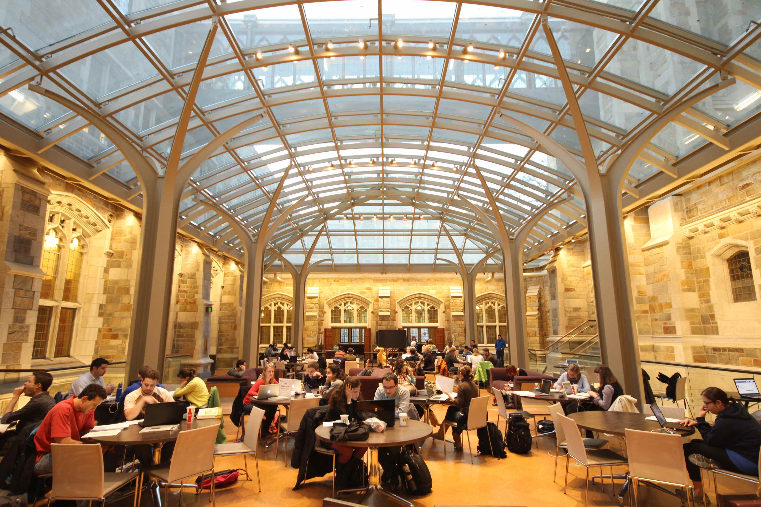
What is the Implicit Curriculum
“The implicit curriculum refers to the learning environment in which the explicit curriculum is presented.” (CSWE, EPAS, 2015)
Notes:
Dan

Slide 10
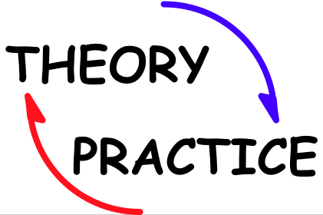
Objective I: Conceptual Framework
Understanding the Implicit Curriculum
Notes:
Dan

Slide 11
Professional Socialization
Professional socialization occurs within three interrelated stages:
  Presocialization
    Occurs prior to entering the social work program
    May also include anticipatory socialization to the profession
  Formal Socialization
    Occurs as a function of the structure of the institution, academic unit, and program that facilitates the curriculum
  Process of Change
    Is contingent on relationships, and choices on whether or how to accept socializing messages received through content and structure
  (Miller, 2013)
Notes:
Dan

Slide 12
Human Interchange
Professional socialization is contingent on the quantity and quality of human interchanges within a program
  (e.g., interactions among students, faculty, staff, community partners, etc.)
Educators should model adaptive interventions when addressing negative interactions in the classroom, or effective communication/behavior when serving on committees
(Bogo & Wayne, 2013)
Notes:
DAn

Slide 13
Empowerment Framework
Empowerment
  A process for increasing personal, interpersonal, or political power so individuals can take actions to improve their life situations
Important components include:
  Self-perceptions of control, feelings of efficacy, or competence to act
Empowerment through the implicit curriculum can inform:
  Identity as a social worker
  Confidence in professional competence, and
  Confidence in potential impact as a social worker
(Peterson et al. 2014b)
Notes:
DAn

Slide 14

Integrated Structural Functionalism and Symbolic Interactionism
Structural functionalism can explain a program’s structure or components of content.
Symbolic interactionism can explain the culture, relationships, and ultimately self-development that occurs within a program
(Miller, 2013)
Notes:
Dan

Slide 15
Influence of Diversity and Difference
Student assessment of the implicit curriculum may differ depending on multiple characters including age, race, program type, etc. (Delong-Hamilton et al., 2017)
Barriers to transgender affirmative social work education including
  (1) transphobic microaggressions within classroom and field settings,
  (2) the absence of transgender specific education and expertise, and
  (3) the general lack of visibility of transgender issues.
  (Austin et al., 2016; Craig et al., 2017)
Notes:
Dan

Slide 16
Summary of Conceptual Frameworks used to Explain the Implicit Curriculum
Implicit curriculum is shaped by:
  Professional Socialization
  Meaning/importance of interactions
  Professional expectations
  Structural components of the program, university, etc.
  Perspective on empowerment
  Diversity of student body
Notes:
Dan

Slide 17
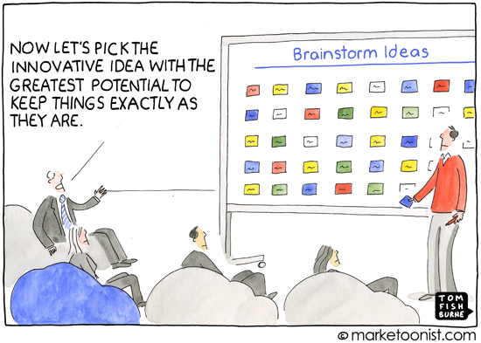
Objective II:
Using Theory to Inform Implementation
Notes:
Kat Krase

Slide 18
Building a Shared Implicit Curriculum
Factors that contribute to building a shared implicit curriculum
  Knowledge
    (Information) is relevant and accessible
  Guidelines
    for the disseminating and accessing information
  Technology
    used to disseminate of information
  Information
    must be curriculum driven – used to enhance the learning culture and ultimately the curriculum
  Student Voice
    as primary consumers of the implicit curriculum, should frame the implicit curriculum
  (Holosko et al., 2010)
Notes:
Kat Krase

Slide 19
Building a Shared Implicit Curriculum (cont.)
  Examples:
    Student Glossary of Terms for BSW Curriculum
    BSW Advising FAQs
    Field Problems and Resources FAQs
Notes:
Kat Krase

Slide 20
Experientially-Oriented Diversity Event
Organized by a diversity committee (faculty, students, and community partners
Organize an event agenda that consists of panel discussions, films, lectures, stations, and small group discussion
Students appreciated learning from their peers in a safe setting
Students learned to be self reflective and respectful of differences through cultural immersion
Ando, 2016
Notes:
Kat Krase

Slide 21
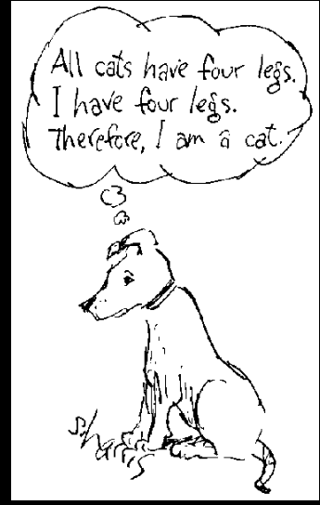
Objective II: Using Empirical Evidence to Inform Implementation
Notes:
Kat Krase

Slide 22
The Implicit Curriculum and Student Sexual Orientation
N = 1,018 nested within 136 institutions
  76% MSW students
  24% BSW Students
Findings:
  Unsupportive climate at school for LGBTQ students
  Lack of LGBTQ Content in curricula
  Social work programs need to better support the integration of LGBTQ students into community
(Craig et al., 2017)
Notes:
Kat Krase

Slide 23
Implicit Curriculum and Transgendered Students
N = 97 students who identified as being a gender or sexual minority
Transgendered Students perceived high levels of transphobia/transconflict from schools, faculty, and in their field placements.
  Many reported transphobic microaggressions, although some indicated affirming trans experiences
Lack of content on issues impacting transgender community in curriculum
Most felt faculty was supportive on issues impacting transgendered students and larger community
(Austin et al., 2016)
Notes:
Kat Krase

Slide 24
The Implicit Curriculum and
Content on Diversity and Social Justice
N = 19, 13 instructors & 6 Graduate Students
Parameters for having dialogue, small class caps, and more time available are suggested
Teaching styles of instructors are crucial, and therefore they need to be screened and mentored
Increase diversity among students and faculty
Content needs to be infused throughout curriculum
Offer a variety of service and learning opportunities
Develop an advanced course in social justice
(Deepak et al., 2015)
Notes:
Kat Krase

Slide 25
Professional Socialization
  N = 489 MSW alumni
  Strongest predicters for having a commitment to social work are a desire to promote social change, and associating social work with lower amounts of prestige
  Strongest predictors for having a social work attitude in consonance with the profession’s mission, history and values are a desire to promote social change and having an anticipatory expectation of social work as a rewarding profession
  Strongest predicter for identifying with social justice is a desire to promote social change
  (Miller, 2013)
Notes:
Kat Krase

Slide 26
Implicit Curriculum Assessment and
Student Characteristics
Relationship of student characteristics to implicit curriculum assessment
  N = 1484 students, nested within 50 social work programs, 90% were undergraduate
  Race
    Black students reported higher satisfaction with policy development and student organizations
    White students reported higher satisfaction with a program providing opportunities for professional advancement
  Gender
    Those that chose not to identify as female or male reported assessed the implicit curriculum less favorably
  (Delong-Hamilton et al., 2017) SWEAP PAPER
Notes:
Kat Krase

Slide 27
Implicit Curriculum Assessment and
Student /Program Characteristics (cont.)
    Age/Academic Level
      BSW students assessed the implicit curriculum more favorably
      Older students reported higher satisfaction with policy development and student organizations
    Employment Status/Financial Aid
      Students receiving financial aid assessed the implicit curriculum more favorably
      BSW Students who worked reported higher satisfaction with policy development and student organizations
    Type of Program
      Students in on-line or hybrid programs rated implicit curriculum more favorably compared to those in program that were solely campus-based
    (Delong-Hamilton et al., 2017)
Notes:
Kat Krase

Slide 28
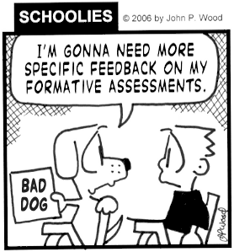
Objective III: Describe Methods for Assessing the Implicit Curriculum
Notes:
Dana

Slide 29
Has anyone assessed the Implicit Curriculum?
Under 2008?
Under 2015?
What did you do? use?
Notes:
Dana

Slide 30
Methodology for Holosko et al. (2010)
Mixed-method approach: 5 step process
  Professional socialization
Quantitative
  web-based counter
  total the number of hits to three steps (student glossary, Advising FAQs, Field problems and resources FAQs)
Qualitative
  Student focus groups: use of the implicit curriculum, as well as the key values/assumptions in which it is framed
Notes:
Dana

Slide 31
Potential Assessment Plan
(Petracchi & Zastrow, 2010)
2008 EPAS series:
Advising Survey
Course Evaluations
Student Assessment of Field Experience
Field Instructor Assessment of Field Experience
Graduating Student Exit Survey
Notes:
Dana

Slide 32
Implicit Factors Survey (Grady et al., 2011)
2008 EPAS; pilot study
Six Factor Assessment Tool – each factor is operationalized by approximately 5 to 10 items – data is quantitative and qualitative
  Field
  Academics
  Community
  Diversity
  Faculty Advising
  Support Services
Notes:
Dana

Slide 33
SWEAP Exit Instrument
(Not just about Implicit Curriculum)
Completed by students just prior to graduation.
  Often administered in field seminar or capstone seminar.
Collects demographic information to compare with the entrance profile.
Professional Activities
  Use of research techniques to evaluate client progress
  Use of program evaluation methodology
Current & anticipated Social Work Employment
  Primary function & major roles
Post Graduate Educational Plans
Notes:
Kris

Slide 34
SWEAP Exit Instrument
(Not just about Implicit Curriculum)
Educational Experience
  How well program prepared them to perform Social Work Competencies (related behaviors)
  Including implicit curriculum assessment
Notes:
Kris

Slide 35
SWEAP Exit Instrument
Implicit curriculum assessed in section F of the instrument
Student assessment of the quality of the program’s:
  Commitment to diversity
  Admissions policies and procedures
  Advisement,
  Policies
  Student participation in governance,
  Role of faculty
  Administrative structure and function
  Resources, and
  Field education program
Notes:
Kris

Slide 36
SWEAP Exit
Notes:
Kris

Slide 37
SWEAP Exit
Notes:
Kris

Slide 38
Benefits of SWEAP
We do the analysis for you
  Automatic reports
National Comparisons
  Building a dataset
More information at SWEAPInstruments.org
Visit our Booth: 35
Notes:
Kris

Slide 39
Any Questions?

Slide 40
References
Ando, S. (2017). Teaching note-Inclusion and diversity content in MSW curriculum using a diversity event. Journal of Social Work Education, 53, 72-78.
Austin, A., Craig, S. L., & McInroy, L. B. (2016). Toward transgender affirmative social work education. Journal of Social Work Education, 52, 297-310.
Bogo, M., & Wayne, J. (2013). The implicit curriculum in social work education: The culture of human interchange. Journal of Teaching in Social Work, 33, 2-14.
Craig, S. L., Iacono, G., Paceley, M. S., Dentato, M. P. Boyle, K. E. H. (2017). Intersecting sexual, gender, and professional identities among social work students: The importance of identity integration. Journal of Social Work Education, 53, 466-479.

Slide 41
References
Deepak, A. C., & Rountree, M. A. (2015). Delivering diversity and social justice in social work education: The power of context. Human Services, 26, 107-125.
DeLong-Hamilton, T., Krase, K., Harris-Jackson, T., Christenson, B., Danhoff, K., Farrel, D., Freedman, D., Gerritsen-McKane, R., Sullivan, D., & Ng, P. (2017, submitted). Exploring Correlates of Implicit Curriculum for Accreditation Outcomes Evaluation: Results of Student Evaluations. Journal of Social Work Education.
EPAS. 2015. Educational policy and accreditation standards, Alexandria, VA: Council on Social Work Education
Exit Instrument (SWEAP, 2016). Delong-Hamilton, T., Krase, K., Christenson, B. Freedman, D., Gerritsen-McKane, R., Harris-Jackson, T., & Panos, P.

Slide 42
References
Grady, M. D., Powers, J., Despard, M., & Naylor, S. (2011). Measuring the implicit curriculum: Initial development and results of an MSW survey. Journal of Social Work Education, 47, 463 – 487.
Holosko, M., Skinner, J., MacCaughelty, C., & Stahl, K. M. (2010). Building the implicit BSW curriculum at a large southern state university. Journal of Social Work Education, 46, 411-423.
Miller, S.E., (2013). Professional socialization: A bridge between the explicit and implicit curricula, Journal of Social Work Education, 49, 368-386.

Slide 43
References
Peterson, N. A., Farmer, A. Y., Donnelly, L., & Forenza, B. (2014b). Assessing the implicit curriculum in social work education: Heterogenity of Students’ experiences and impact of professional empowerment. Journal of Teaching in Social Work, 34, 460-479.
Peterson, N. A., Farmer, A. Y., & Zippay, A. (2014a). The implicit curriculum in an urban university setting: Pathways to Students’ empowerment. Journal of Social Work Education, 50, 630-647.
Petracchi, H. E., & Zastrow, Z. (2010). Suggestions for utilizing the 2008 EPAS in CSWE-accredited baccalaureate and masters curriculums-reflections from the field, part 2: The implicit curriculum. Journal of Teaching in Social Work, 30, 357-366.

