Slide 1
Reporting on Field Practicum/Placement Assessment Instrument (FPPAI) in an instant: competencies, behaviors, dimensions.
BPD 2018
Atlanta, GA
www.SWEAPINSTRUMENTS.ORG
Notes:
Tobi

Slide 2
What is SWEAP?
SWEAP is committed to providing the highest quality assessment instruments
SWEAP instruments are designed to be responsive to the 2015 EPAS of the Council on Social Work Education (CSWE)
However, each social work program is individually responsible for appropriately reporting and interpreting data provided through SWEAP instruments to CSWE.
Notes:
Tobi

Slide 3
What is SWEAP? Social Work Education Assessment Project
Non-Profit
Volunteer
Service to Profession
Based out of Metropolitan State University of Denver
RESULT:
6 (copyrighted) instruments in support of program assessment and curriculum development.
Notes:
Tobi

Slide 4
The SWEAP Team
Tobi DeLong-Hamilton Brandeman University
doctdh@gmail.com
Dorothy Farrell
Brandeman University
farrel.dorothy@gmail.com
Brian Christenson Capella University brian.christenson@capella.edu
Ruth Gerritsen-McKane University of Utah ruth.gerritsen-mckane@socwk.utah.edu
Dana Sullivan
Western Kentucky University
Dana.sullivan@wku.edu
Kathryn Krase
Long Island University, Brooklyn
kathryn.krase@liu.edu
Dan Freedman
University of South Carolina
Daniel.freedman@sc.edu
Kristin Danhoff
Metropolitan State University of Denver
kdanhoff@msudenver.edu
Tameca Harris-Jackson
University of Central Florida
Tameca.harris-jackson@ucf.edu
Phil Ng
Our Technical Guru!
Phillip_Ng@URMC.Rochester.edu
Notes:
Tobi

Slide 5
The 2015 Field Practicum/Placement Assessment Instrument
(FPPAI)
Notes:
Kathryn

Slide 6
Overview
This session reports on the development of the 2015 Field Practicum/Placement Assessment Instrument (FPPAI), a standardized measure of student outcomes related to the 2015 EPAS.
Learning Objective 1* Participants will able to describe the benefits of using a standardized field instrument that is aligned with the 2015 EPAS standards.
Learning Objective 2* Participants will be able to describe how the FPPAI is a comprehensive instrument that is responsive to all necessary components of EPAS standards: competencies, behaviors, and dimensions.
Learning Objective 3* Participants will be able to articulate the benefits of using online-standardized instruments in program assessment related to field education.
Notes:
Kathryn

Slide 7
Outcomes Being Examined Should Relate to All CSWE Competencies
Accreditation (or reaffirmation) is a “high stakes” activity where all programs are likely to be required to demonstrate equivalency.
Notes:
Kathryn

Slide 8
SWEAP Can Cover 2015 CSWE EPAS Assessment
CSWE EPAS 2015 requires programs to assess multiple dimensions of each of the nine (9) Social Work Competencies.
SWEAP Field Practicum/Placement Assessment Instrument (FPPAI) & Foundation Curriculum Assessment Instrument (FCAI), in combination, cover requisite multi-dimensional measures of each of competency.
Four (4) Dimensions:
Knowledge (FCAI)
Values (FPPAI)
Skills (FPPAI), and,
Cognitive & affective processes (FPPAI).
Notes:
Kathryn

Slide 9
FPPAI
Responds to need for a standardized assessment instrument
measures student achievement of competencies, behaviors, dimensions
Multiple dimensional measures per competency:
Values, Skills, and/or Cognitive & Affective Processes
Provides:
Individual student outcomes reports, and
Aggregated outcomes reports
Using program defined benchmarks.
Compared to other programs nationally - also, similar programs by size, type, and region.
Notes:
Kristin

Slide 10
Updated 2015 FPPAI
Items deconstruct competencies
ie: Micro, Macro, & Mezzo levels.
50 Likert Scale items linked to the EPAS 2015
Competency level
Behavior level
Multiple dimensions linked to the EPAS 2015.
Qualitative feedback available for each competency.
Available online and in print format (until July 2018)
Final field assessment and mid/post-test design.
BSW
MSW Foundation Year
MSW Advanced Practice (customization available)
Notes:
Kristin

Slide 11
Multi-Dimensional Assessment
“EPAS recognizes a holistic view of competence; that is, the demonstration of competence is informed by knowledge, values, skills, and cognitive and affective processes that include the social worker’s critical thinking, affective reactions, and exercise of judgment in regard to unique practice situations”
To insure multi-dimensional assessment of each Social Work Competency, SWEAP developed operational definitions for values, skills, and, cognitive and affective processes dimensions.
Notes:
Kristin

Slide 12
SWEAP Operationalization: Value, Skills, and, Cognitive & Affective Processes
Values: The field instructor is able to observe the intern’s adherence to (ability to follow) social work core values (Service, social justice, the dignity and worth of the person, the importance of human relationships, integrity, competence, human rights, and scientific inquiry), as defined by CSWE. It is worth noting that this definition does not imply that the student imbues (internalizes) these values; rather, that the student demonstrates the ability to practice according to these professional values.
Skills: The field instructor is able to observe the student’s ability to execute professional behaviors in the field that demonstrate the integration and application of what they have learned through their social work education.
Cognitive and Affective Processes: The field instructor is able to observe the student’s ability to engage in critical thinking and utilize affective reactions to exercise appropriate judgment when working with or on behalf of the client/client system, peers, colleagues, and/or the community.
Notes:
Kristin

Slide 13
Competency | Dimension(s) Covered
 | FCAI | FPPAI
Competency 1–Demonstrate Ethical and Professional Behavior | Knowledge | Values Skills Cog & Aff Proc
Competency 2 –Engage Diversity and Difference in Practice |  | Values Skills Cog & Aff Proc
Competency 3 –Advance Human Rights and Social, Economic, and Environmental Justice |  | Skills
Competency 4 –Engage In Practice-informed Research and Research-informed Practice |  | Cog & Aff Proc
Competency 5 –Engage in Policy Practice |  | Values Skills Cog & Aff Proc
Competency 6 –Engage with Individuals, Families, Groups, Organizations, and Communities |  | Cog & Aff Proc
Competency 7 –Assess Individuals, Families, Groups, Organizations, and Communities |  | Cog & Aff Proc
Competency 8 –Intervene with Individuals, Families, Groups, Organizations, and Communities |  | Skills Cog & Aff Proc
Competency 9 –Evaluate Practice with Individuals, Families, Groups, Organizations, and Communities |  | Skills Cog & Aff Proc
Notes:
Dana

Slide 14
Model Learning Plan
Competency 1: Demonstrate Ethical and Professional Behavior Social
Behaviors | Selected Task & Activities | Methods of Evaluation
Make ethical decisions by applying the standards of the NASW Code of Ethics, relevant laws and regulations, models for ethical decision-making, ethical conduct of research, and additional codes of ethics as appropriate to context;
use reflection and self-regulation to manage personal values and maintain professionalism in practice situations;
demonstrate professional demeanor in behavior; appearance; and oral, written, and electronic communication;
use technology ethically and appropriately to facilitate practice outcomes; and
use supervision and consultation to guide professional judgment and behavior.
Complete Model Learning Plan available for $49.99 on Sweapinstruments.org
Notes:
DAna

Slide 15
Deconstruction of competencies for evaluation
From learning plan to evaluation
Increases the reliability and validity
COMPETENCY ONE:
Demonstrate Ethical and Professional Behavior
Intern demonstrates professional demeanor in behavior
Intern demonstrates professional demeanor in appearance
Intern demonstrates professional demeanor in oral communication
Etc…
Notes:
Dana
Aggregate at comp level and behavior level for a score

Slide 16
FPPAI Reports
Individual Student Report
Can be printed out for student and field instructor to retain copies.
Can be saved as pdf for electronic records.
Aggregated Report
Includes scores for individual behaviors/items under each competency,
Full scale score for each competency, and
Scores at the competency level that reflect at least one dimension (values, skills, and/or cognitive and affective processes) for each competency
Notes:
Dana

Slide 17
Two formats: Reporting in an instant!
Paper
Online
Notes:
Dan

Slide 18
FFPAI Overview
Instrument
Reports
Notes:
dan

Slide 19
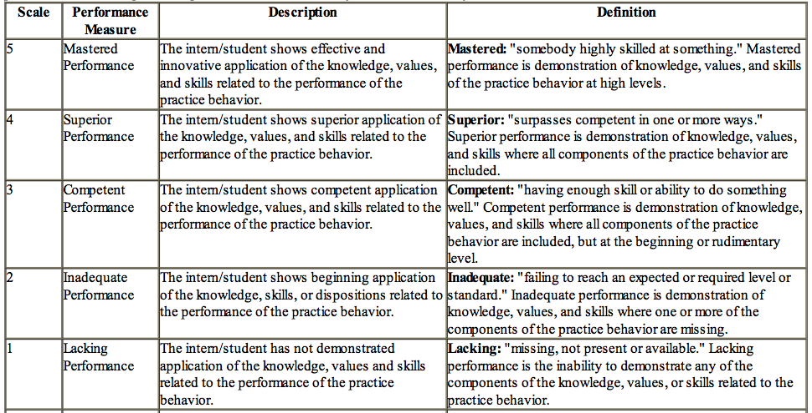
New FPPAI Scale (2015)
5 point Likert scale
Description and Definition provided
Used for each deconstructed competency
Notes:
Dan

Slide 20
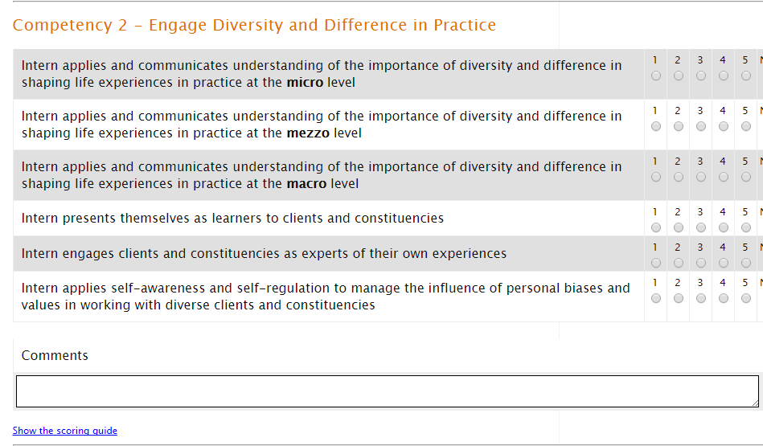
FPPAI Question Example (online)
Notes:
Dan

Slide 21
FPPAI Sample Report
Competency Level
2.1.6 - Engage with Individuals, Families, Groups, Organizations, and Communities
Competency | Average Score | # meeting competency | # exceeding competency
Intern applies knowledge of human behavior and the social environment, person-in-environment, and other multidisciplinary theoretical frameworks to engage with clients and constituencies | 4.33 / 5 | 3 (100%) | 2 (100%)
Intern uses empathy, reflection, and interpersonal skills to effectively engage diverse clients and constituencies. | 4.33 / 5 | 3 (100%) | 2 (100%)
Total Section Score | 4.33 / 5 | n/a | n/a
Total Section - Number of Students Meeting All Competency Benchmarks (3=competent) | n/a | 3 (100%) | n/a
Total Section - Number of Students Exceeding All Competency Benchmarks (3=competent) | n/a | n/a | 2 (100%)
Dimension Level
Skills
Competency | Average Score | # meeting competency | # exceeding competency
Intern presents themselves as learners to clients and constituencies | 2.67 / 5 | 2 (40%) | 0 (0%)
Intern engages clients and constituencies as experts of their own experiences | 3.67 / 5 | 3 (60%) | 2 (40%)
Intern applies their understanding of social justice to advocate for human rights at the individual and system levels | 4.33 / 5 | 2 (40%) | 3 (60%)
Total Section Score | 3.57 / 5
Notes:
Dan

Slide 22
FPPAI Sample Report
Individual Level
2.1.6 - Engage with Individuals, Families, Groups, Organizations, and Communities
Intern applies knowledge of human behavior and the social environment, person-in-environment, and other multidisciplinary theoretical frameworks to engage with clients and constituencies 2.1.CogAff,
Intern uses empathy, reflection, and interpersonal skills to effectively engage diverse clients and constituencies. 2.1.CogAff,
Finn Stormtrooper – Superior application of the appropriate theory to client systems. | 5 | 5
Bridget Donner- Bridget demonstrated appropriate knowledge of theoretical frameworks and utilized her knowledge in working with her clients; she did additional research to understand the stages and development of each individual client in order to best work with them and their foster families. She utilized empathy in understanding her clients and supervision to process, reflect and improve upon her service delivery. | 4 | 4
Example report
LINK TO VIDEO
Notes:
Dan

Slide 23
MSW Advanced Practice Instrument Customization
SWEAP can customize online instruments.
Customized FPPAIs, including Specialized Practice Competencies for graduate programs, piloted with four (4) different programs with great success!
First Customization
A base customization fee of $250 includes a first run of up to 50 instruments.
After initial run, you just pay the regular per instrument fee.
Customization Overview
If interested free consulting is available, provided by the SWEAP FPPAI team.
Notes:
Tameca

Slide 24
FFPAI at a glance
177 programs using the 2015 EPAS aligned FPPAI instruments
National comparisons found under public forms in account (optional to report)
For 2015 EPAS comparisons – ask for updated report
7085 returns
In April 2017, announced:
Based on expert feedback, and meetings with key stakeholders, the SWEAP team has removed the N/O (Not Observed) category from the SWEAP Field Placement/Practicum Assessment Instrument (FPPAI).
Continual updates and responsiveness provided for online FFPAI
Online FAQs, consultations
Notes:
Tameca

Slide 25
Questions?
Notes:
The Team

